Slide 1

Tittle
AI-Driven Traffic Signal Control: Enhancing Efficiency,
Safety, and Mobility
Prof.Santos Kumar Das , Prof. Sadananda Behra
Akash Saha , Suryansh Khatri , Gyanes Biswas , Sai Susmitha ,
NATIONAL INSTITUTE OF TECHNOLOGY ROURKELA

Slide 2
Project Overview
- Real-time detection of traffic violations
- Smart traffic signal control based on vehicle density
- Uses AI, computer vision
- Aims to improve road safety and traffic efficiency

Slide 3
Vehicle Detection & Tracking
- Detects cars, motorcycles, buses, and trucks
- Assigns unique tracking IDs (SORT algorithm)
- Calculates speed using pixel-to-meter conversion

Slide 4
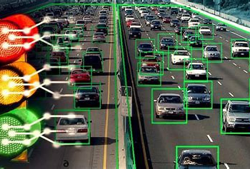
Violation Detection
- Speeding violations
- Lane crossing detection
- Helmet detection
- Triple riding on bikes
- License plate recognition & tracking

Slide 5
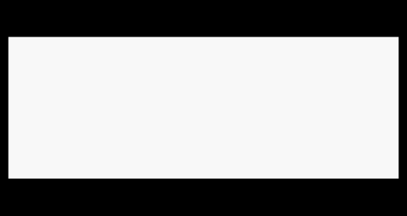
Smart Traffic Signal System
- Adaptive signal timing using vehicle density
- Vehicle weights: Car (1), Bike (0.5), Bus (2), Truck (1.5)
- Countdown-based signal display

Slide 6
Tools & Technologies Used
Tracker:
Languages/Libs:
Models:
Database:
Python, OpenCV, EasyOCR, NumPy
YOLOv8, Helmet detection, License plate detection
SORT
CSV File

Slide 7
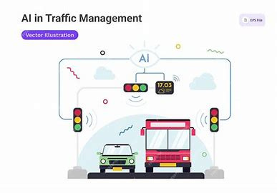
Expected Outcomes
Tools & Technologies Used
Real-time license plate check
Matches against MongoDB records
- Sends alert if criminal plate found
- Database: vehicle_data → criminal_records

Slide 8
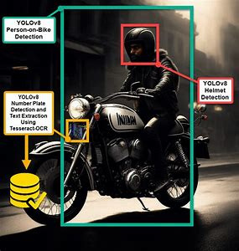
Limitations & Future Scope
Limitations:
Lighting & camera angle dependency
Speed accuracy relies on calibration
Future Scope:
Cloud-based criminal DB integration
Support for adverse weather/night detection
Edge device deployment (Jetson Nano, Raspberry Pi)

Slide 9
Conclusion
- Complete traffic enforcement + smart signal solution
- Reduces manual intervention and increases safet
- Ready for real-world deployment in smart cities

Slide 10



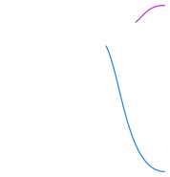

FLOWCHART
Identify Riders without Helmets
Recognize License Plates Using OCR
Helmet Detection & License Plate Recognition
Cross-check with Criminal/Police Database
Send violation report to traﬃc authorities
Triple Riding Detection
Generate violation ticket and store in database
Trigger real-time alert to nearby law enforcement
Traﬃc Violations Detection
Wrong Way Driving Detection
Capture vehicle image & timestamp for issuing ﬁnes
Signal Jumping Detection
Stolen Vehicle Detection (License Plate Cross-Check)
Cross-check with crime database & notify police if matched
Frame Preprocessing & Resizing
Object Detection (YOLO Model)
Vehicle & Crime Monitoring
Identify ﬂeeing vehicle & send alert with video evidence
Hit and Run Detection
Record instance & integrate
with penalty system
Video Capture (IP Camera / Local Webcam)
No Seatbelt Detection
Detect Vehicles (Cars, Bikes, Trucks, etc.) Detect Persons (Riders, Pedestrians)
Crowd Monitoring
Detect large gatherings & alert municipal authorities if needed
Pedestrian & Crowd Safety
Loitering Detection
Track individuals in restricted zones & notify security
Falling Person Detection
Send immediate medical assistance request if detected
Law Enforcement Actions
Generate Reports for Traﬃc Police
Store Data in Database (MongoDB)
Send Violation Alerts to Authorities in Real Time

Slide 11
Thank you

